Slide 1
Estrogen as an immunomodulator and its role in multiple sclerosis prevention: a systematic review
Kuang-Ying (Bruce) Chen
Alberto Dominguez-Bali, MD

Slide 2
Research Question
How does estrogen modulate immune function, and what is its role in preventing autoimmune diseases in at-risk populations?
Population: Individuals with autoimmune diseases or at risk.
Intervention: Estrogen or estrogen-based therapies.
Comparison: Non-estrogen therapies or placebo.
Outcome: Immunomodulation, autoimmune disease incidence/prevention.

Slide 3
Protocol
Inclusion Criteria:
Studies on humans relevant to estrogen's effects on immune function.
Peer-reviewed journals.
Specific autoimmune diseases: lupus, RA, MS, GPA, psoriasis, Sjögren's syndrome, allergy etc
Timeframe: last 10 years
Exclusion Criteria:
Non-English studies
Irrelevant topics:
non-immune functions of estrogen,
No mention of estrogen
Studies on animal models
Register the protocol with PROSPERO.

Slide 4
Comprehensive Literature Search
PubMed: ("Estrogens"[MeSH] OR Estrogen) AND ("Immune System Diseases"[MeSH] OR "Autoimmune diseases" OR lupus OR SLE OR RA OR “rheumatoid arthritis” OR MS OR “multiple sclerosis” OR “GPA” OR “granulomatosis with polyangiitis” OR Wegener OR Wegener’s OR psoriasis OR Sjogren OR Sjögren OR Sjogren’s OR Sjögren’s OR allergy OR allergies) AND ("Hormone Therapy"[MeSH] OR Prevention)
Filters applied: in the last 10 years.
581 results: pubmed-EstrogensM-set (PubMed).nbib

Slide 5
("Estrogens"[MeSH] OR Estrogen) AND ("Immune System Diseases"[MeSH] OR "Autoimmune diseases" OR lupus OR SLE OR RA OR “rheumatoid arthritis” OR MS OR “multiple sclerosis” OR “GPA” OR “granulomatosis with polyangiitis” OR Wegener OR Wegener’s OR psoriasis OR Sjogren OR Sjögren OR Sjogren’s OR Sjögren’s OR allergy OR allergies OR "Diabetes Mellitus, Type 1"[MeSH]) AND ("Hormone Replacement Therapy"[MeSH] OR “Estrogen Replacement Therapy"[MeSH] OR Prevention)

Slide 6
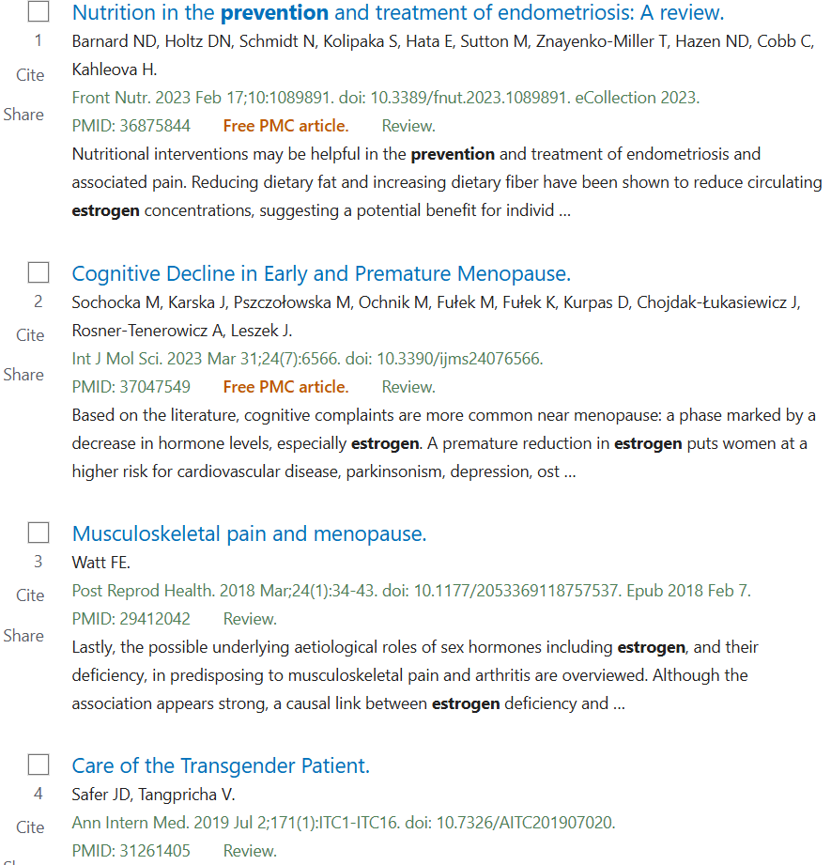
PubMed

Slide 7
Comprehensive Literature Search
Embase: ('estrogens'/exp OR 'estrogens' OR 'estrogen'/exp OR 'estrogen') AND ('immune system diseases'/exp OR 'immune system diseases' OR 'autoimmune diseases'/exp OR 'autoimmune diseases' OR 'lupus' OR 'sle'/exp OR 'sle' OR 'rheumatoid arthritis'/exp OR 'rheumatoid arthritis' OR 'ra' OR 'multiple sclerosis'/exp OR 'multiple sclerosis' OR 'ms' OR 'granulomatosis with polyangiitis'/exp OR 'granulomatosis with polyangiitis' OR 'wegener' OR 'wegeners' OR 'psoriasis'/exp OR 'psoriasis' OR 'sjogren' OR 'sjögren' OR 'allergy'/exp OR 'allergy' OR 'allergies') AND ('hormone therapy'/exp OR 'hormone therapy' OR 'prevention'/exp OR 'prevention') AND [2015-2025]/py
3,562 results: records(Embase).ris

Slide 8
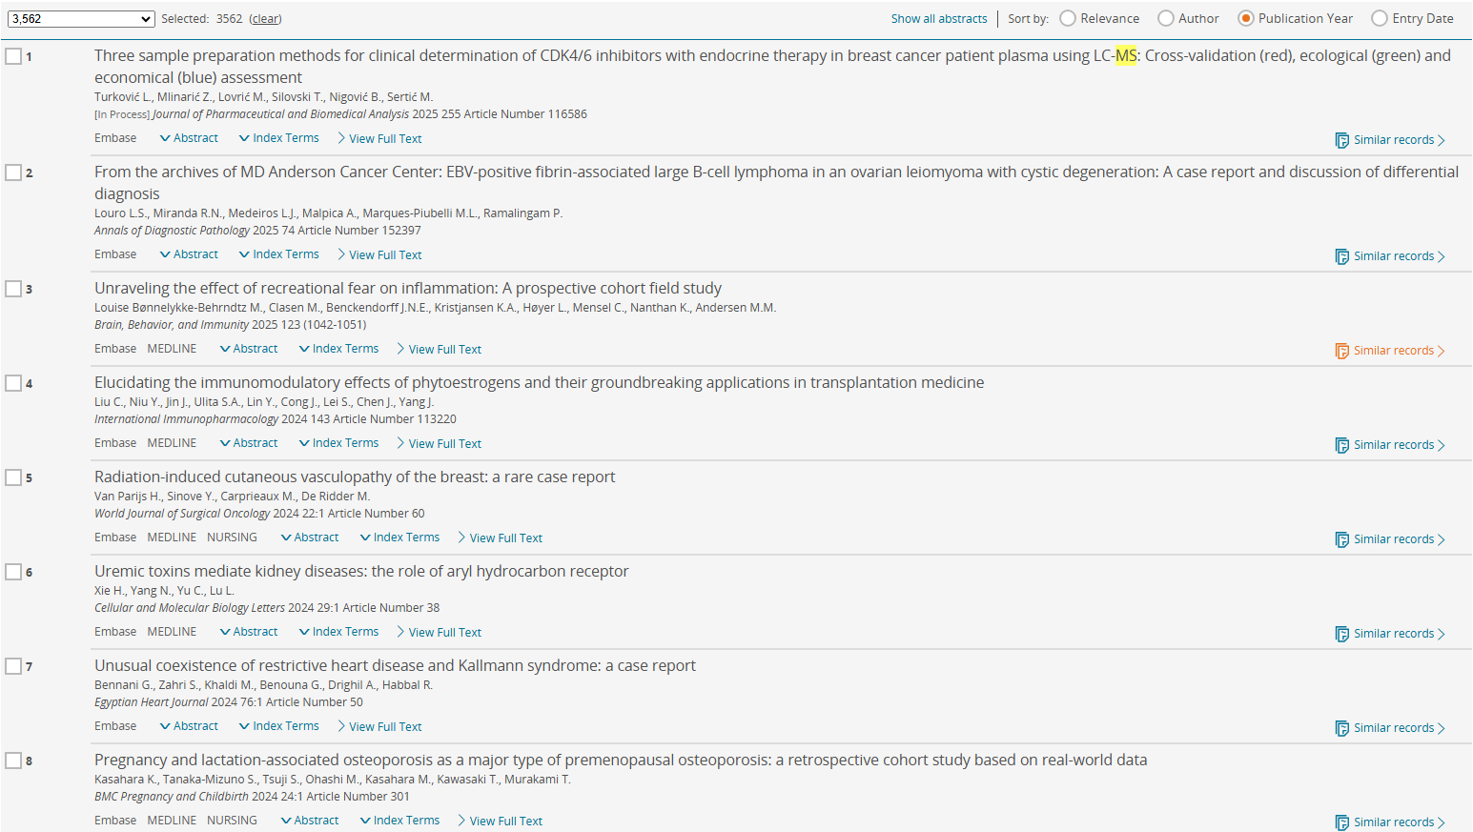
Embase

Slide 9
Comprehensive Literature Search
Cochrane Library: (Estrogens OR Estrogen) AND ("Immune System Diseases" OR "Autoimmune diseases" OR lupus OR SLE OR RA OR “rheumatoid arthritis” OR MS OR “multiple sclerosis” OR “GPA” OR “granulomatosis with polyangiitis” OR Wegener OR Wegener’s OR psoriasis OR Sjogren OR Sjögren OR Sjogren’s OR Sjögren’s OR allergy OR allergies) AND ("Hormone Therapy" OR Prevention)
with Cochrane Library publication date from Jan 2015 to present, (Word variations have been searched)
4 Cochrane Reviews: citation-export (Cochrane Review).ris
78 Trials: citation-exports(CochraneTrials).ris
0 results matching 'Intervention "Estrogens" AND Outcome ( "Autoimmune Disease" OR "Lupus Erythematosus" OR "Multiple Sclerosis" OR "Rheumatoid Arthritis")'

Slide 10
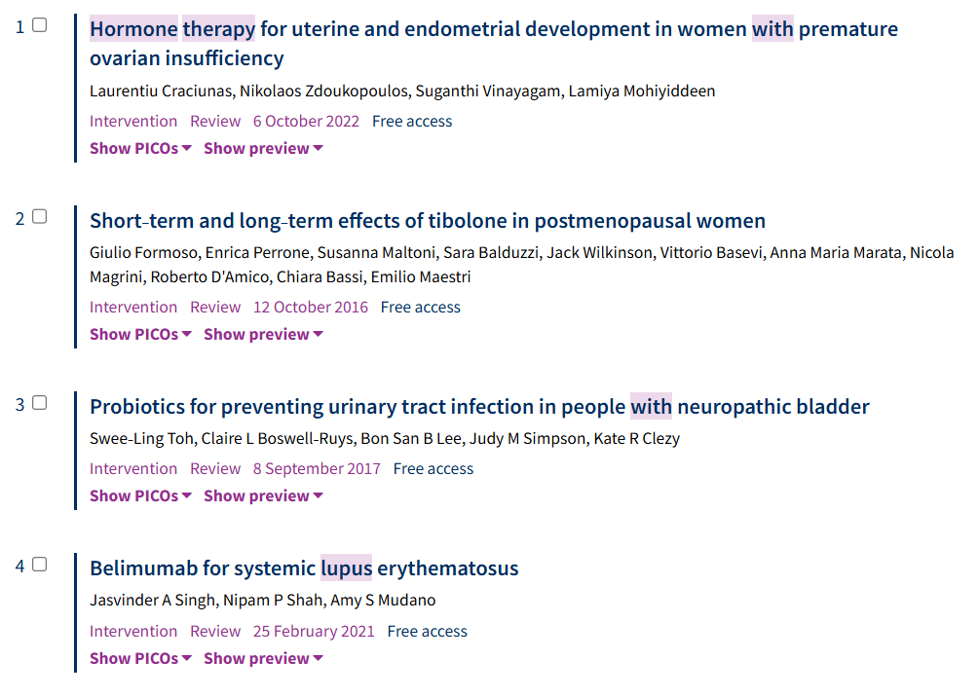
Cochrane Reviews

Slide 11
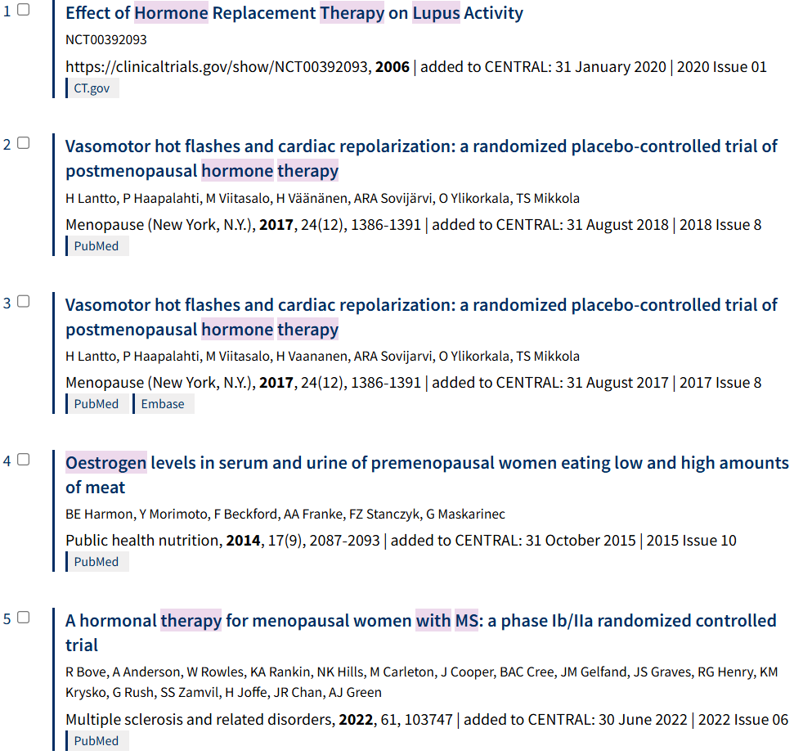
Trials

Slide 12
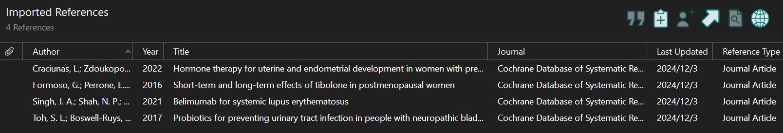
Cochrane Review

Slide 13
Comprehensive Literature Search
Web of Science: TS=(Estrogens OR Estrogen) AND TS=("Immune System Diseases" OR "Autoimmune diseases" OR lupus OR SLE OR RA OR “rheumatoid arthritis” OR MS OR “multiple sclerosis” OR “GPA” OR “granulomatosis with polyangiitis” OR Wegener OR Wegener’s OR psoriasis OR Sjogren OR Sjögren OR Sjogren’s OR Sjögren’s OR allergy OR allergies) AND TS=("Hormone Therapy" OR Prevention)
| Timespan: 2015-01-01 to 2024-12-31 (Publication Date)
167 Documents: savedrecs (Web of Science).ris

Slide 14
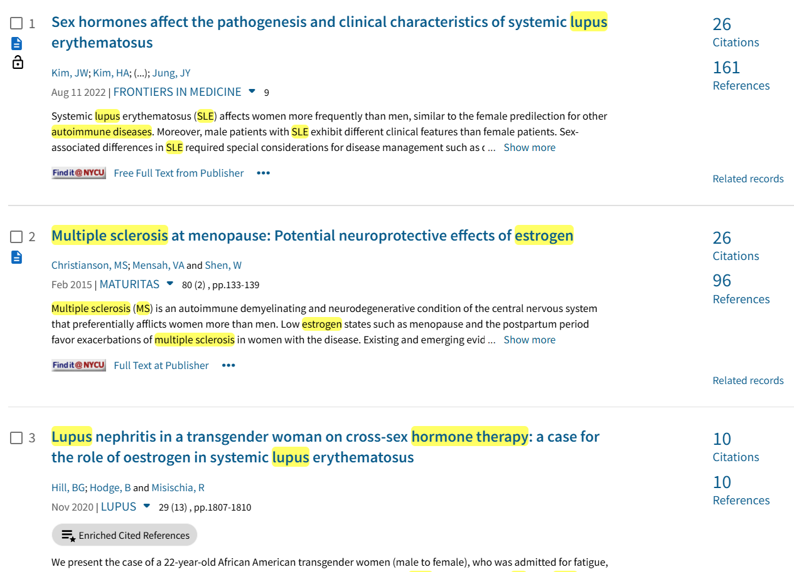
Web of Science

Slide 15
Review Data
4392 articles are identified.
864 duplicates are detected.
510 are deleted.
354 are resolved.
3882 articles to screen: articles to screen ris.zip

Slide 16
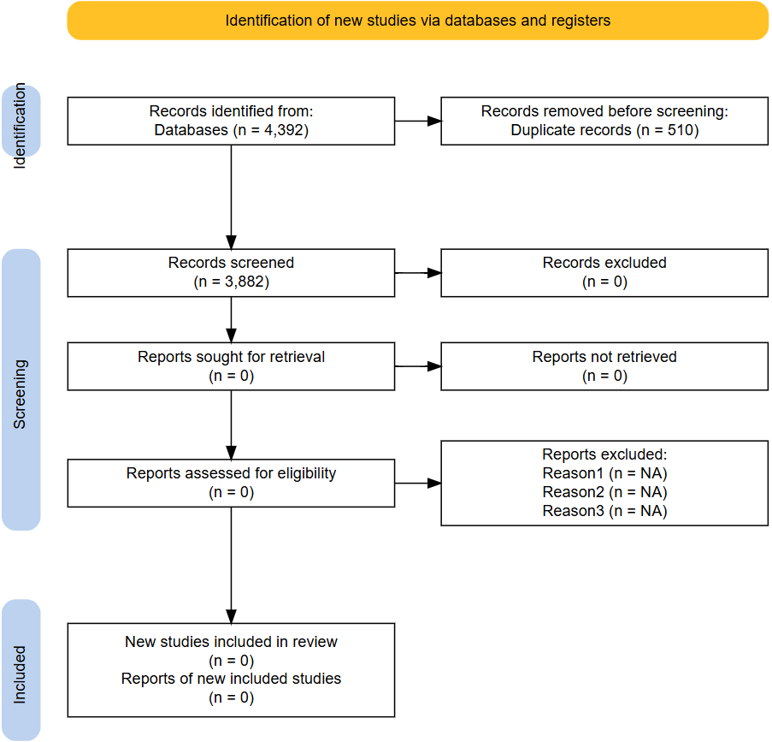
PRISMA Flow Diagram

Slide 17
Screening
Web of Science: 6 included. 51 excluded.
Cochrane Trials: 3 included. 37 excluded.
Cochrane Review: 0 included. 3 excluded.
Included: included articles ris (Cochrane Library & Web of Science).zip
Excluded: excluded articles ris (Cochrane Library & Web of Science).zip

Slide 18
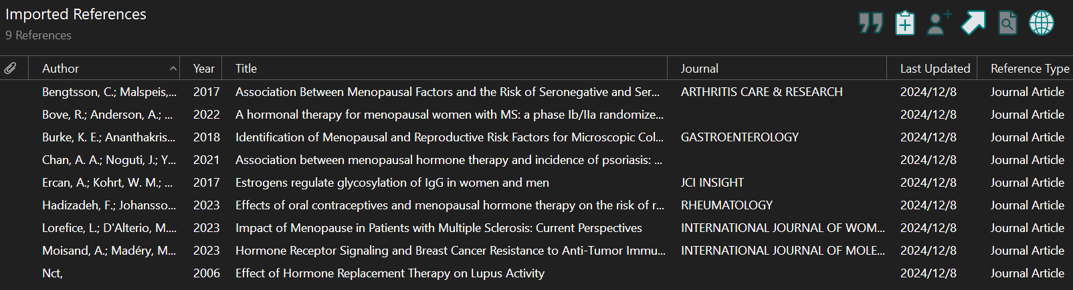
Included articles

Slide 19
Screening
ChatGPT 4o categorized articles: Categorized_Articles.csv
Included articles: 297 records. Included - Categorized_Articles.csv

Slide 20
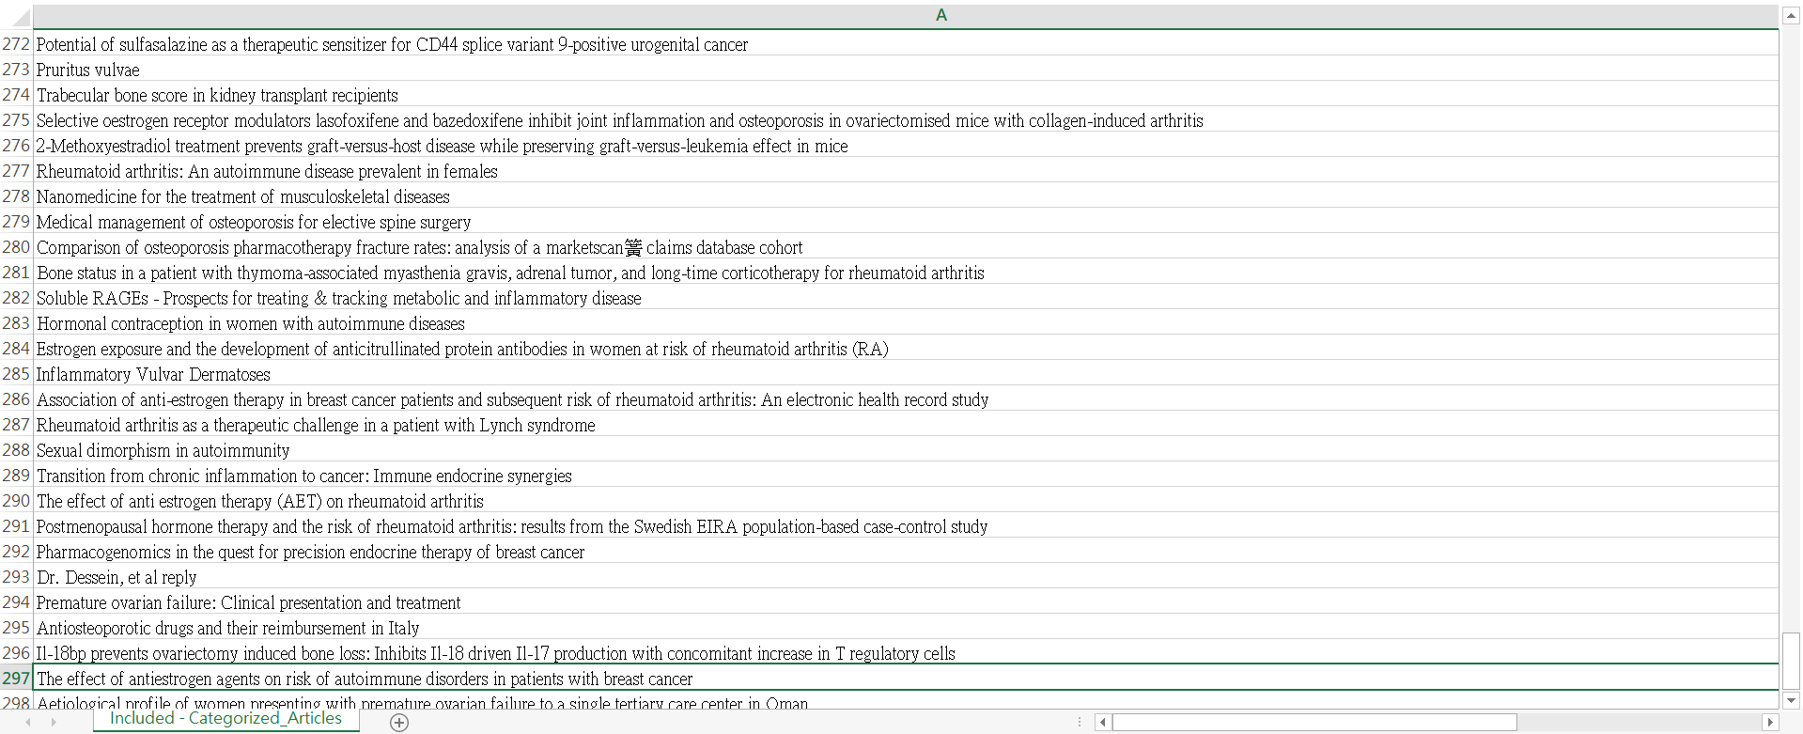
Included articles

Slide 21
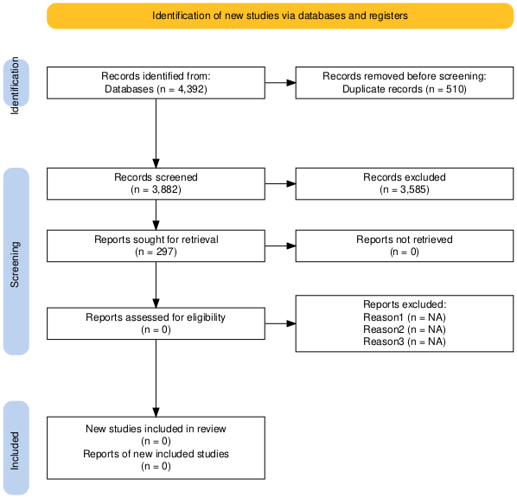
PRISMA Flow Diagram

Slide 22
Automatic exclusion
Automation tool: ChatGPT 4o
Prompt: Review study titles to exclude obvious non-relevant topics.
Not excluded: Relevant_Articles_for_Review.csv
2617 articles

Slide 23
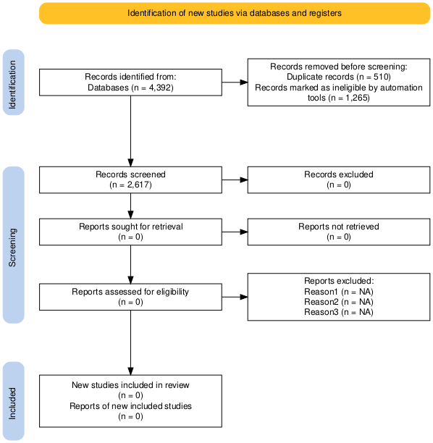
PRISMA Flow Diagram

Slide 24
Included articles
Included: 138 articles
Full text: https://drive.google.com/drive/folders/1HLX0h62yaKxmXZijJbYUfb-o0R_7a9au?usp=drive_link

Slide 25

PRISMA Flow Diagram

Slide 26
Acknowledgement
Ting-Zhen (Melissa) You resolved duplicated articles and organized full texts.
Taiyou Lin created ChatGPT prompt.

